Slide 1
Strings
ICS 4U0

Slide 2
String Variables
Strings are two or more combinations of characters, digits or characters.
Strings have apostrophes around them
“Hello, world”
“I live @ 1150 Dream Crest Rd.”
Strings variables are NOT the same as the data type variables you’ve seen (eg. int, double, float, char)
Strings are OBJECTS
String variables are “Reference-type” variables

Slide 3
Declaring a String
Same steps as before:
specify the variable type (in this case, String)
name it something (called the identifier)
String firstName, lastName;
String address;
Initialize a String variable the same:
firstName = “Jim Nasium”;
address = “123 Dreamy Crescent”;

Slide 4
Strings: Reference Type Variables
The contents of the String variable are stored in another location in memory
The memory location of “Jim Nasium” is stored in firstName.
This value is a REFERENCE to the memory location where the “Jim Nasium” is stored.
5,189
firstName
“Jim Nasium”
5,189

Slide 5
Strings: Reference Type Variables
String name = “Mr. North”;
name = “Ms. South”;
String variable name now contains a new value which points to the location in memory which contains “Ms. South”
“Mr. North” still exists in memory, but there is no way to find where he is…he is lost, forever!
2,532
30,099
name
“Mr. North”
“Ms. South”
30,099
2,532

Slide 6
String Variables
String bizTeacher = “Mr. North”;
4,120
bizTeacher
String techTeacher = “Mr. North”;
Is bizTeacher equal to techTeacher? Why or why not?
“Mr. North”
4,120
bizTeacher is NOT equal to techTeacher because the values in each variable are different (4,120 ≠ 912).
912
techTeacher
“Mr. North”
912

Slide 7
String Variables
4,120
bizTeacher
4,120
techTeacher
“Mr. North”
4,120
the answer can also be true if the compiler attempts to save memory and allocates them to the same location in memory

Slide 8
Strings: reference-type variables
Due to the fact that String variables are objects, and are therefore stored differently than the 8 primitive data types
Lesson learned ---- Strings do NOT work well with relational operators!!!
use methods instead
5,189
firstName
“Jim Nasium”
5,189

Slide 9
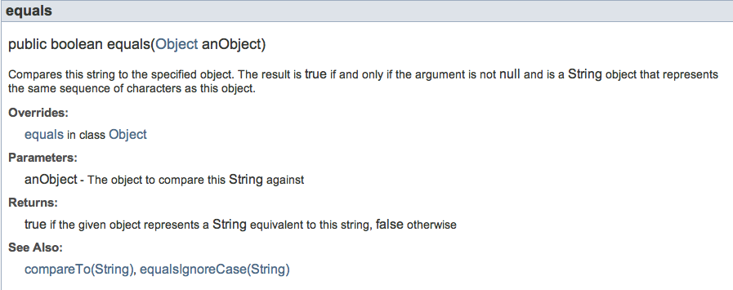
the String Class
notice how this method in the String class compares the object

Slide 10
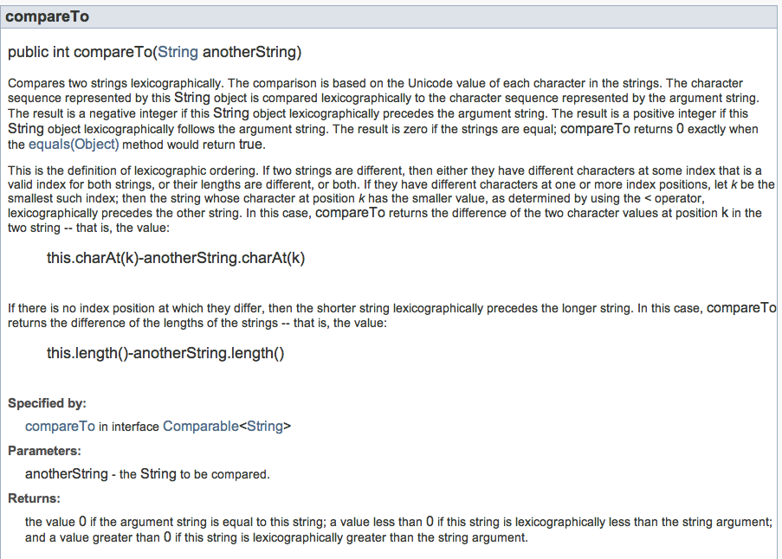
compareTo

Slide 11
compareTo
compares each String, reading left to right, character by character. It returns:
0 if Strings are identical (eg. “be”.compareTo.”be”)
a negative integer is returned if the first String precedes the second String in any way (eg. “haT”.compareTo.”hat”)
the ‘T’ (84) is a lower unicode # than ‘t’ (116)
84-116 = -32
a positive integer is returned if the second String precedes the first String in any way (eg. “hat”.compareTo.”haT”)
the ‘t’ (116) is a higher unicode # than ‘T’ (84)
116-84 = 32

Slide 12
Additional String Functions
Length—
s1.length()
Replacing characters—
s1.replace(“i”,”e”);
Searching for patterns—
vowels.indexOf(“eio”);
Concatenation—
s1.concate(s2)

